Slide 1
ICT & Software Engineering
13 – Classes & Objects
14 – Windows Forms APP
From case to design

Slide 2

Content
Topics of this lecture
Creating a class design

Slide 3

From problem to a solution
Determine business requirements
Translate business requirements to a model
Transform a model into a class diagram
Implement class diagram
Test implementation

Slide 4

Practice: Event system
On Canvas there is a case description about an Event System to support an organization with their work
For now we focus on the part related to gaining access to the event. Perform the following steps:
Determine business requirements
Translate business requirements to a model
Transform a model into a class diagram
When time permits, you can then implement your design to experience what consequences your design choices have (i.e. the final two steps).

Slide 5
Practice: Event system - Extend
On Canvas there is a case description about an Event System to support an organization with their work
Implement the your design to experience what consequences your design choices have (i.e. the final two steps). When done, perform the same steps to extend it with:
Handling the exiting of the event
Transferring money
Buying products
Viewing statistics

Slide 6
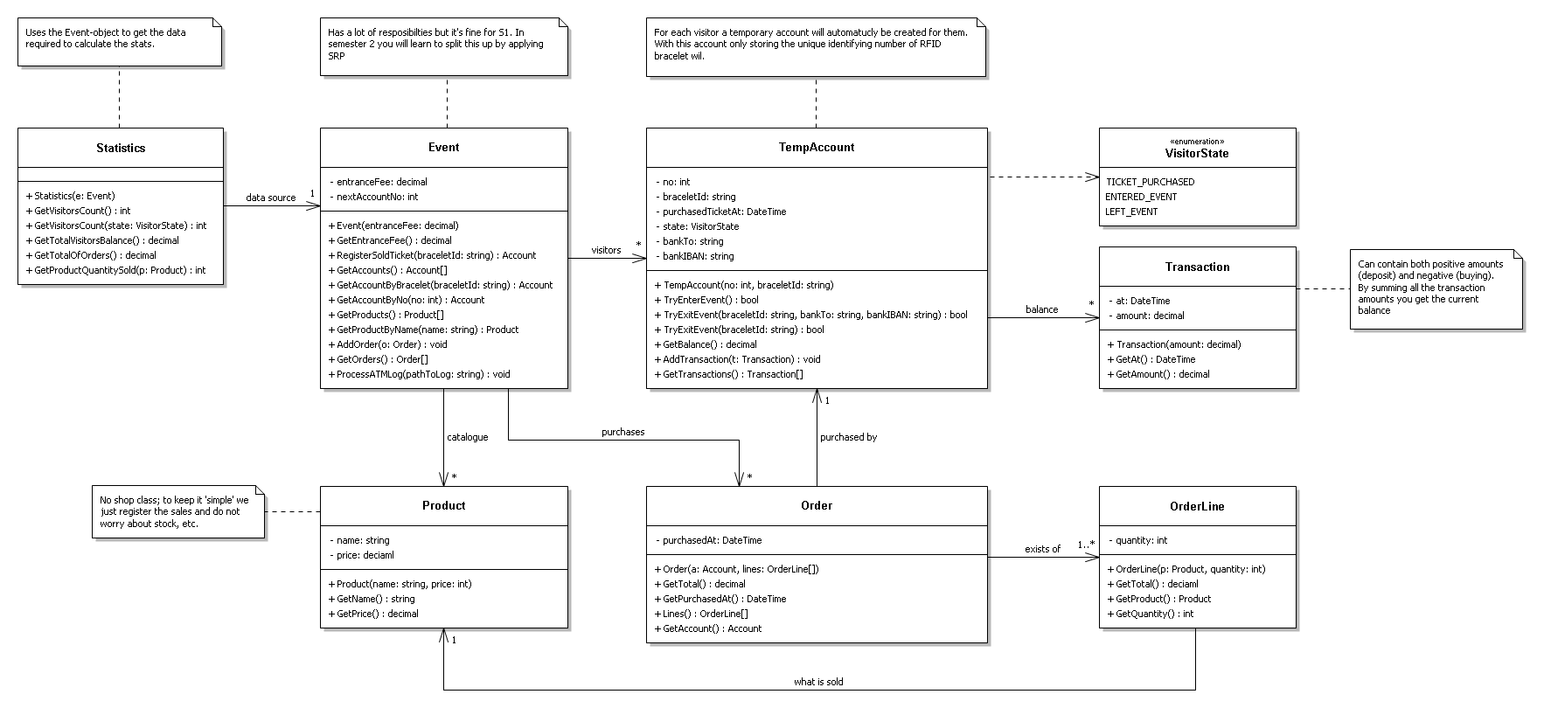

Slide 7

Questions?

Slide 8

What to do next?
Week 18 is feedback session (i.e. no more lectures)

